Slide 1

RUNGTA COLLEGE OF DENTAL SCIENCES & RESEARCH
TITLE OF THE TOPIC ; Mandibular Movements Part -2
DEPARTMENT OF PROSTHODONTICS AND CROWN & BRIDGE

Slide 2
Specific learning Objectives
At the end of this presentation the learner is expected to know ;
Core areas* | Domain ** | Category #
Introduction | Cognitive | Must Know
Methods of studying mandibular movements | Cognitive | Must Know
Importance | Cognitive | Must Know
Factors which regulate jaw motion | Cognitive | Must Know
Mandibular positions | Cognitive | Must Know
The clinical understanding | Cognitive | Must Know
Take Home Message | Cognitive | Must Know
References | Affective | Desired to know

Slide 3
Objectives
To understand the types of mandibular movements and its effect on prosthesis i.e in vertical, horizontal and sagittal axis

Slide 4
Contents
Introduction
Methods of studying mandibular movements
Importance
Factors which regulate jaw motion
Mandibular positions
The clinical understanding
Take Home Message
References

Slide 5
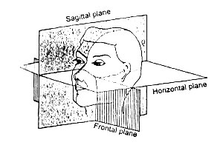
Axes of mandibular rotation
Rotation occurs around three axes: transverse, vertical and sagittal, that move constantly during normal jaw function.
Notes:
These are instantaneous axis.

Slide 6
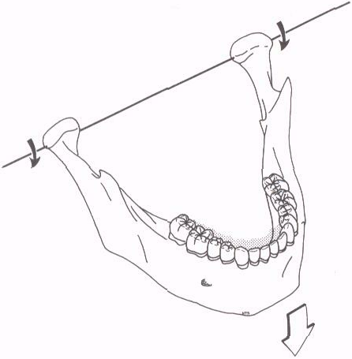
Movement about a horizontal axis, as seen in a hinge axis opening.
Notes:
During opening n closing, a pure rota movement, used 2 orient mx cast on articulator.

Slide 7
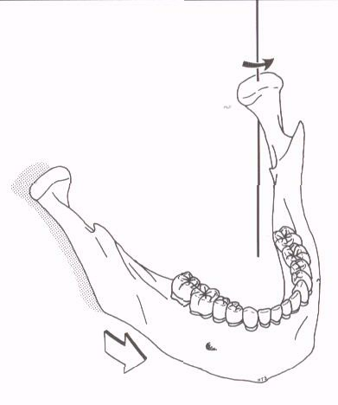
Movement occurs around a vertical axis during a lateral excursion.
Notes:
In lateral excursion. One condyle moves antr out of terminal hinge. Other still.

Slide 8
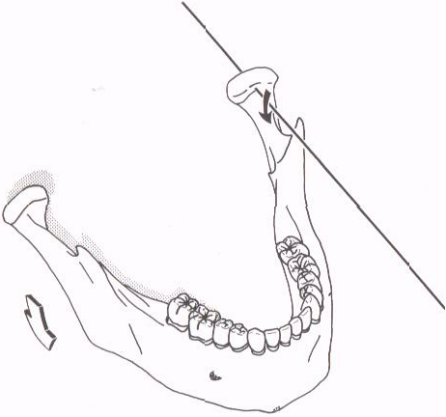
The mandible also rotates around a sagittal axis when one side drops down during a lateral excursion
Notes:
One condyle moves inferiorly out of terminal hinge position.

Slide 9
SAGITTAL PLANE BORDER & FUNCTIONAL MOVEMENTS:-
Border movements
When the mandible moves through outer range of motion, reproducible describable limits result, which are called border movements.
Posterior opening border.
Anterior closing border.
Superior contact border.
Functional.

Slide 10
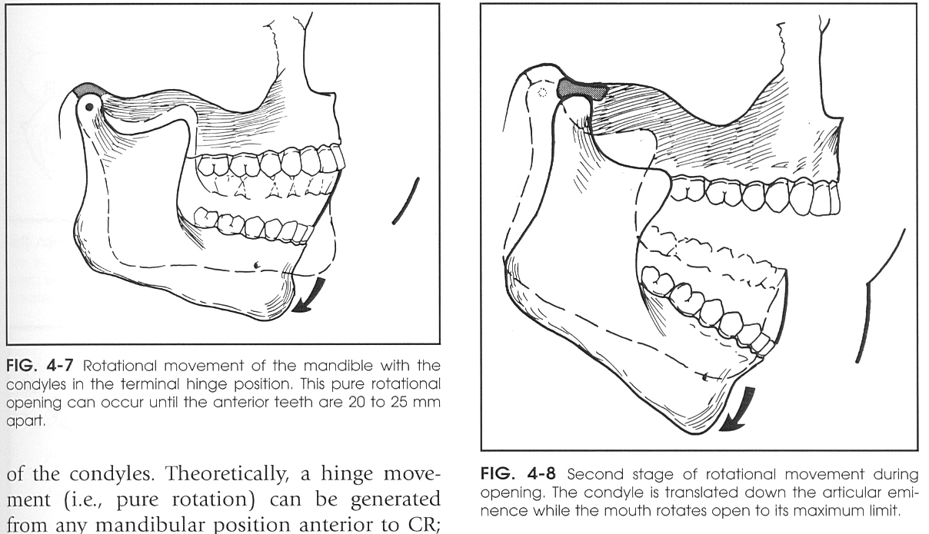
Posterior opening border movement
Anterior and posterior opening border movements are limited primarily by ligaments and TMJ musculature.
Superior contact border limited by occlusal and incisal surfaces of teeth.
1st STAGE
Condyles: terminal hinge position
Pure rotational movement
2ND STAGE
Axis of rotation shifts to bodies of rami.

Slide 11
1st STAGE
Opening range: 20-25mm
The movements are the only repeatable hinge axis movement of mandible.
2ND STAGE
Condyles: anteriorly &
inferiorly.
Mandible: posteriorly & inferiorly.
Max opening: 40-60mm.

Slide 12
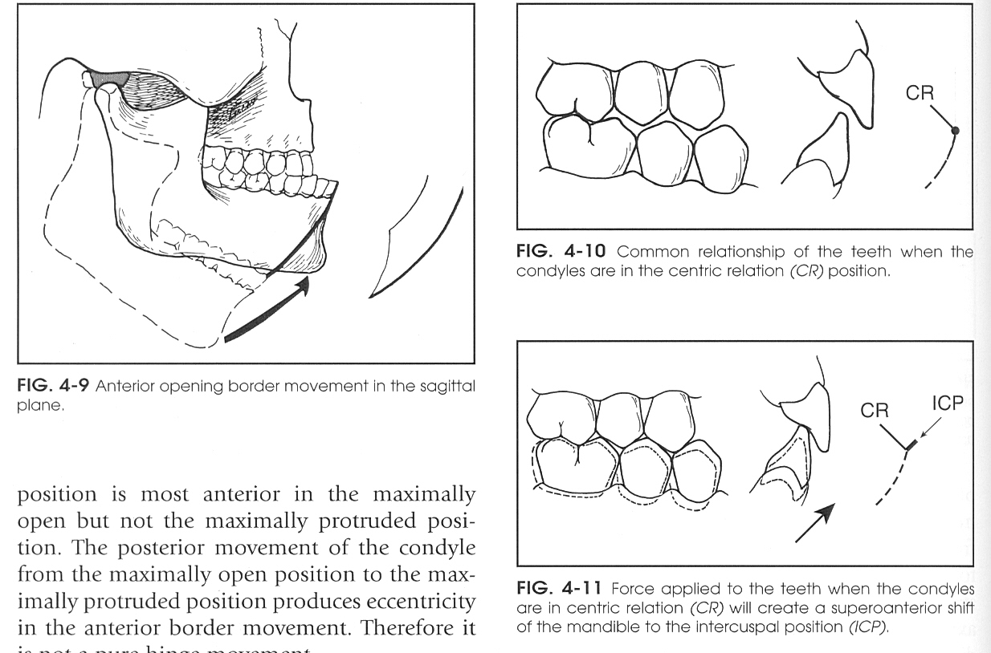
Anterior closing Border Movements:-
Generated when closure accompanied by contraction of inferior lateral pterygoid.
Not a pure hinge movement due to eccentricity.

Slide 13
Superior Contact Border Movements
Throughout this entire border movement tooth contact is present.
It depends on:-
  Amount of variation between centric relation and maximum intercuspation.
  The steepness of the cuspal inclines of the posterior teeth.
  Amount of vertical and horizontal overlap of anterior teeth
  Lingual morphology of maxillary anterior teeth.
  General inter arch relationships of the teeth.

Slide 14
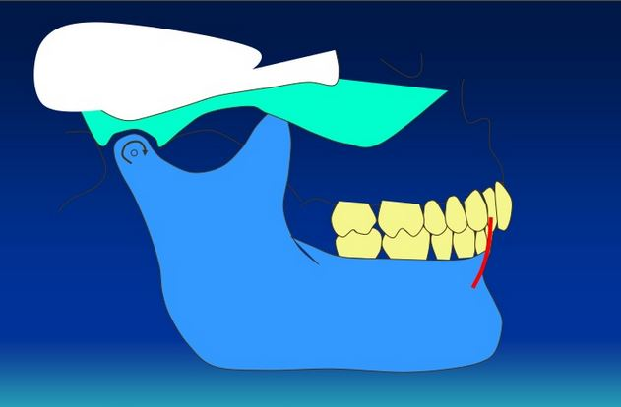
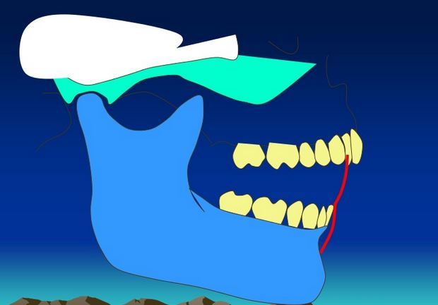

Slide 15
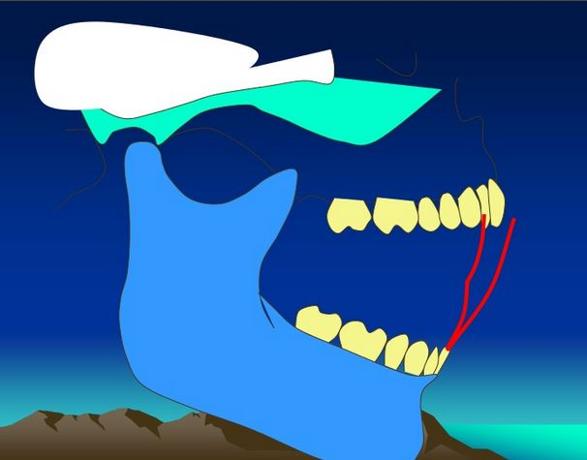
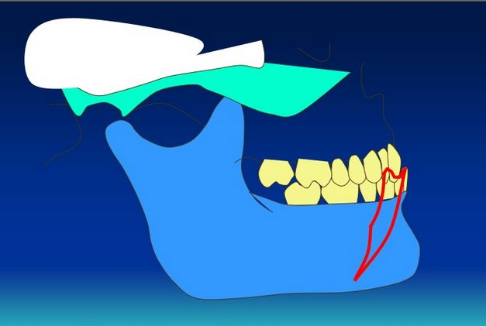

Slide 16
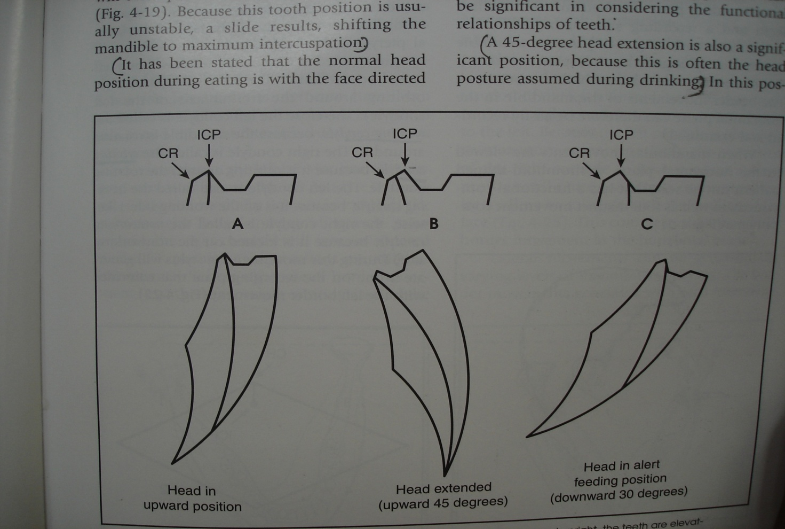
EFFECT OF POSTURE
Notes:
In erect posture, postural position is 2-4mm below intercuspal position. Path of closure can be antr or postr to this.

Slide 17
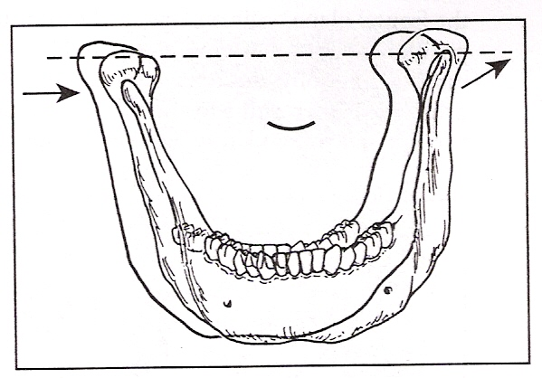
Left lateral superior movement
Frontal/Vertical axis movement

Slide 18
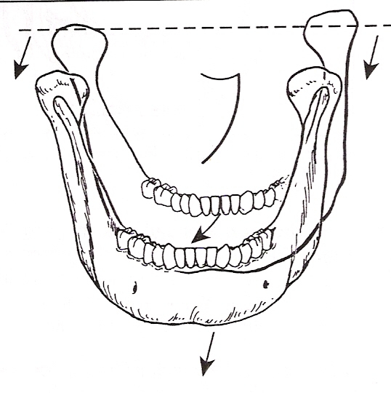
Left lateral opening movement

Slide 19
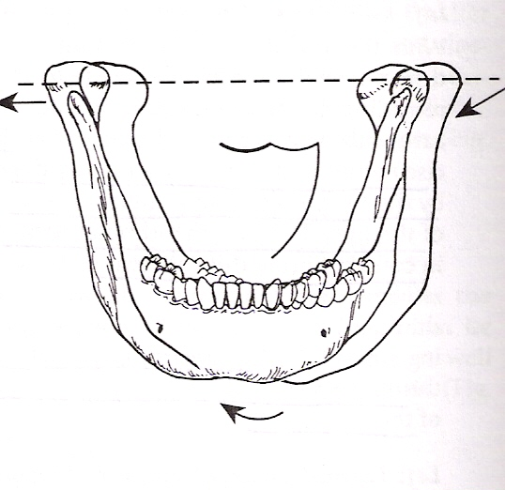
Right lateral superior border movement

Slide 20
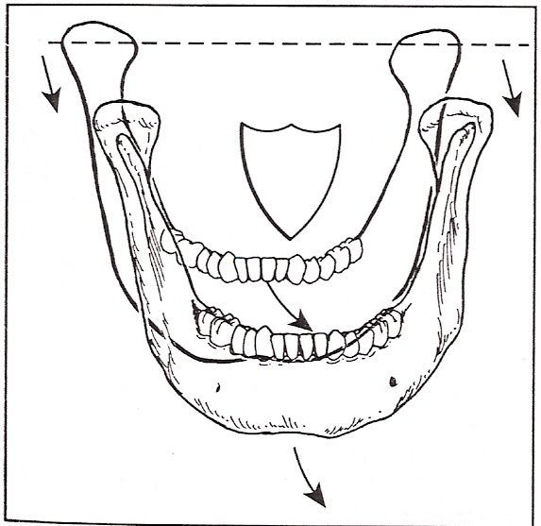
Right lateral opening border movement

Slide 21
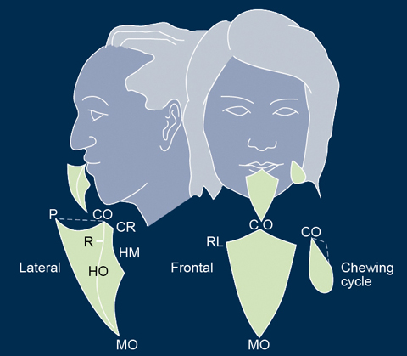
Maximum movements-
Opening : 50-60 mm
Lateral : 10 to 12 mm
Protrusive : 8 to 11 mm
And retrusive range is about 1 mm.

Slide 22
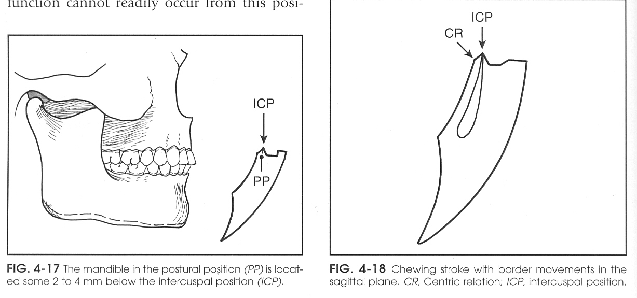
Functional Movements:-
Occur during functional activity of mandible.
Free movements: take place within border movements.
Occur chiefly around centric.

Slide 23
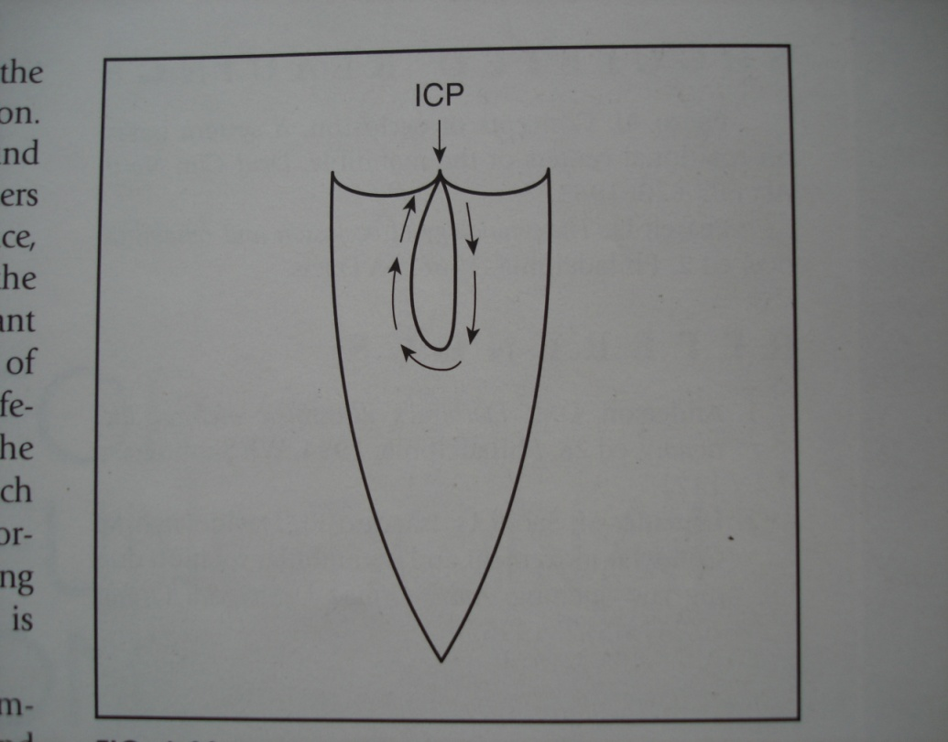
Functional Movements:-
During chewing, the mandible drops directly inferiorly until the desired opening is achieved.
It then shifts to the side on which bolus is placed and rises up.
As it approaches maximum intercuspation, bolus is broken down between the opposing teeth.
In the final closure, the mandible quickly shifts back to the intercuspal position.

Slide 24
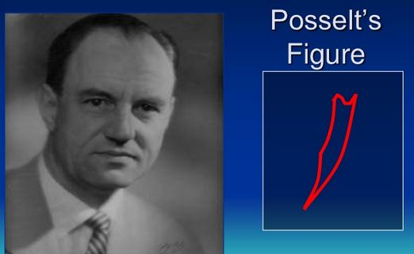
Envelope of Motion
Gives reference positions from where fundamental movements of mandible occur-
  Helps in making vertical & horizontal jaw relation records
CR– MHO :represents Posterior terminal hinge movement, which is used to locate transverse hinge axis for mounting of casts on articulator.
  The rest position is a guide to
  re-establishing the proper vertical
  dimension of occlusion.

Slide 25
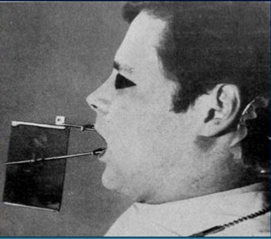
Envelope of Motion
Multiple restorations and
complete dentures are so
constructed that their occlusion is in harmony with centric relation, because mastication in dentulous occurs at CO but in edentulous at CR.
Except at the occlusal contact position, where envelope of movement is controlled by teeth, all other contours are controlled by muscles, joints and soft tissue forces.

Slide 26
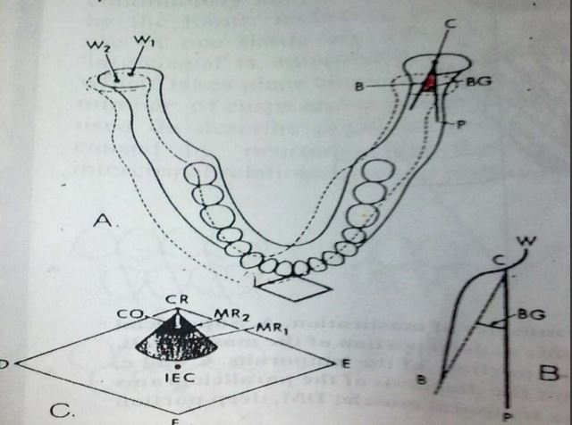
The gothic arch or arrow point tracing.
Horizontal Plane
It is a graphic registration of lateral border movements on a horizontal plane, which results in an angular tracing.
The direction of lateral movements is actively determined by the lateral pterygoid muscle on nonworking side and by the deep capsular ligaments of condyle on working side.
Notes:
The lateral mandibular movements are of great importance because they influence the intercuspation of teeth in working mastication.

Slide 27
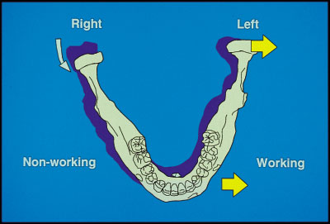
Working & Nonworking Side
The side toward which the mandible moves in a lateral excursion is called Working side
And
The Nonworking side is that side of mandible that moves toward median line in a lateral excursion

Slide 28
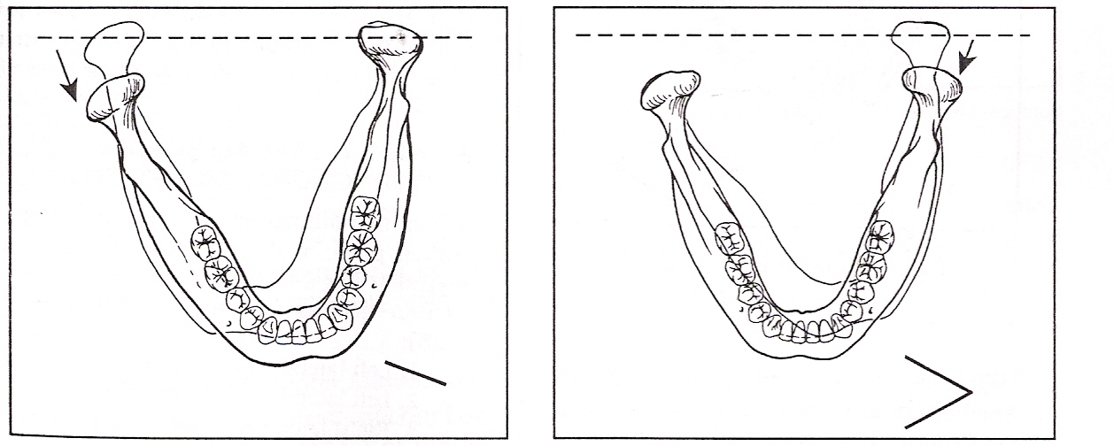
Left lateral border movement

Slide 29
Continued left lateral border movement with protrusion

Slide 30
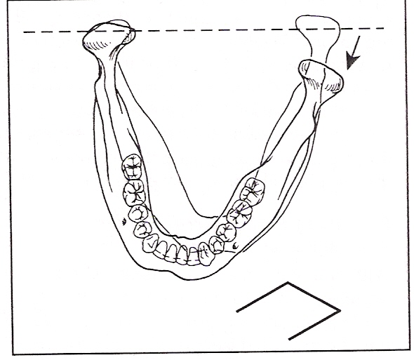
Right lateral border movements
Condyles in CR
Contraction of left inferior
lateral pterygoid
Left condyle moves
anteriorly,medially and
Inferiorly

Slide 31
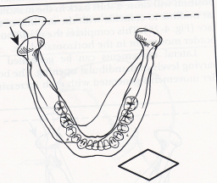
Continued right lateral movement with protrusion
Contraction of rt. lateral pterygoid & continued contraction left inferior pterygoid
Right condyles moves anteriorly and to left
Mandibular midline coincides with midline of face

Slide 32
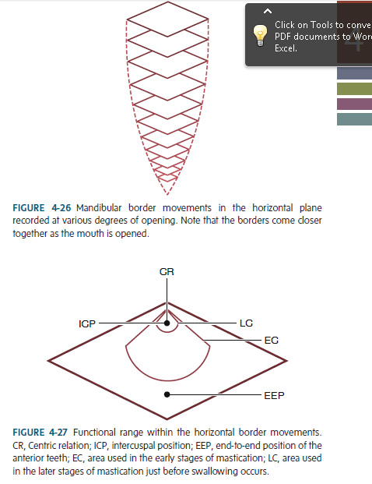

Slide 33
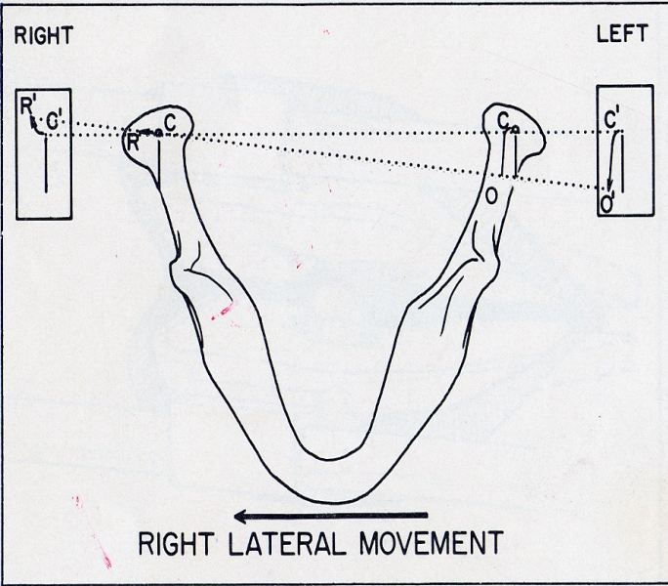
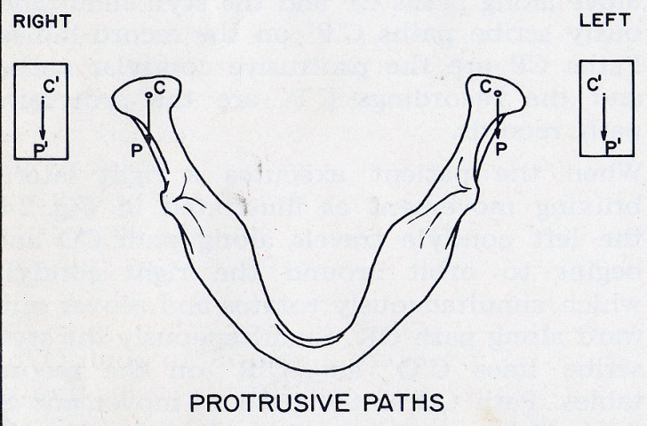
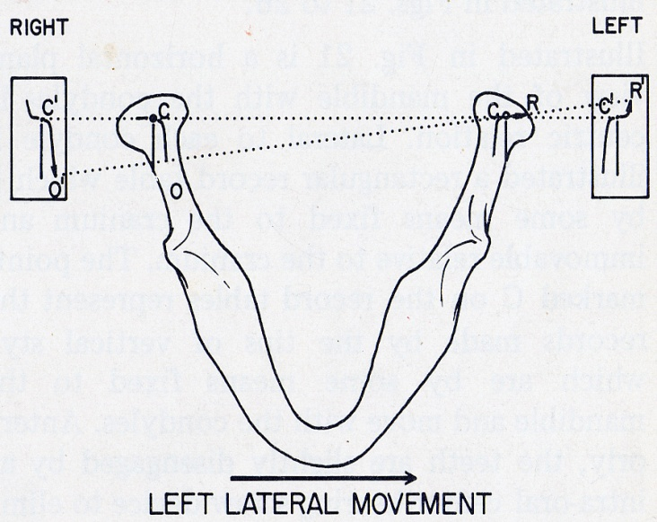
Bennett shift
Described by Dr. Norman Bennett in 1908 , it is the direct lateral side shift that occurs simultaneously with a lateral excursion

Slide 34
The primary cause :is the contraction of lateral pterygoid muscle because its origin is located medially to its insertion.
When mandible shifts to the side, its movement occurs in two segments- an immediate side shift in which the major direction of movement is mediolateral
and a progressive side shift, which begins thereafter and continues with the major direction of movement being anterior.

Slide 35
Physiological rest position
Established by muscles and gravity.
Is actively determined.
It is a ‘range of posture’
Usually 2-4mm below maximum intercuspation position, but can be upto 10 mm.
Remains relatively stable for reasonable periods of time.
Affected by short and long term intra oral and general health factors and by position of head.

Slide 36
TAKE HOME MESSEGE
Knowledge of Jaw Movements is Essential for Successful Treatment of Patients. It is imperative to learn as much possible about jaw movement, in order to reproduce those aspects of its motion, considered necessary for proper functioning of the occlusion, either natural or artifici

Slide 37
References
Complete denture prosthodontics – 3rd edition, by John J Sharry
Prosthodontic Treatment for Edentulous Patients – by Zarb and Bolender, 12th edition.
An evaluation of mandibular border movements: Their character and significance - Harry C. Lundeen

Slide 38
Thank you !!!

